Slide 1
FINANCE IN AI SOCIETE GENERAL DATASET
DONE BY | B.VARSHINI
DATE | 24-01-2018
MEETING NO | 5

Slide 2
COMPARISON BETWEEN TRAINING AND TESTING SET
Portfolio_id are in consecutive format.
Starts from 1 to 14,148.
Random points are selected and given as testing set.
No of portfolio_id in testing set : 4801
No of portfolio_id in testing set : 9366
Total: 14,167
Actual : 14,148
For eg, missing point PF00001021.

Slide 3
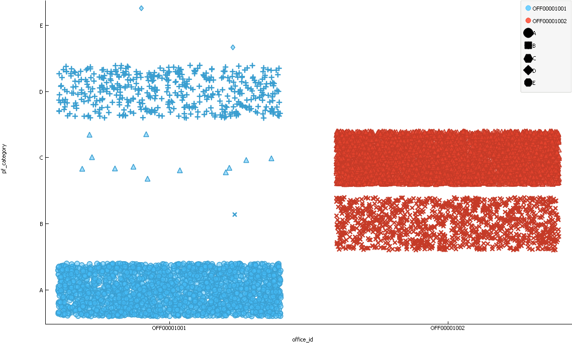
PF_CATEGORY AND OFFICE_ID [Training]

Slide 4
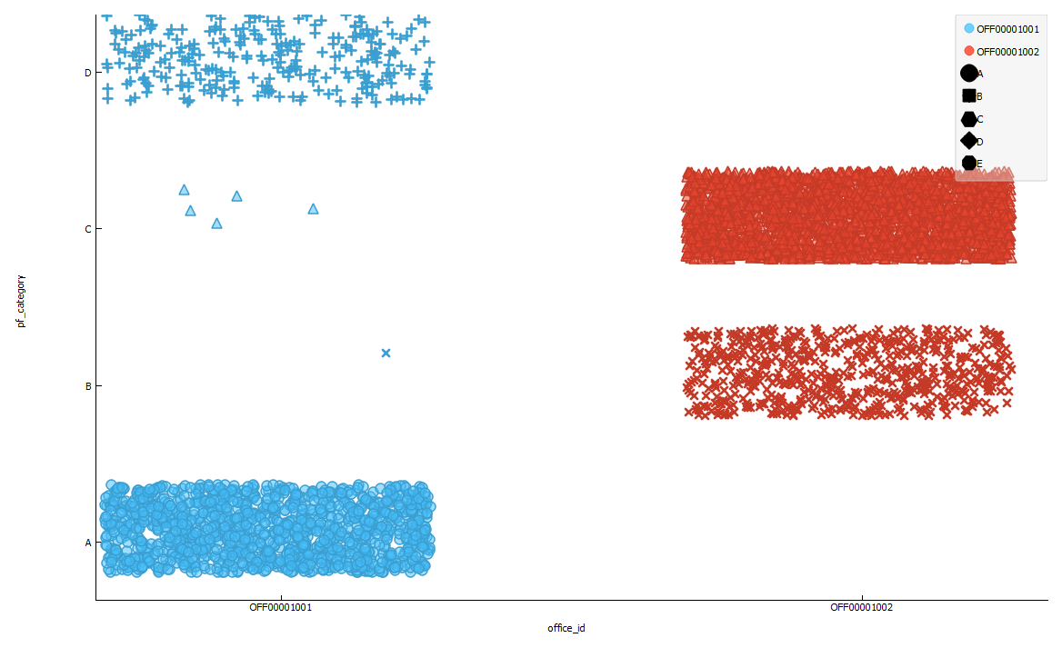
PF_CATEGORY AND OFFICE_ID [Test]

Slide 5
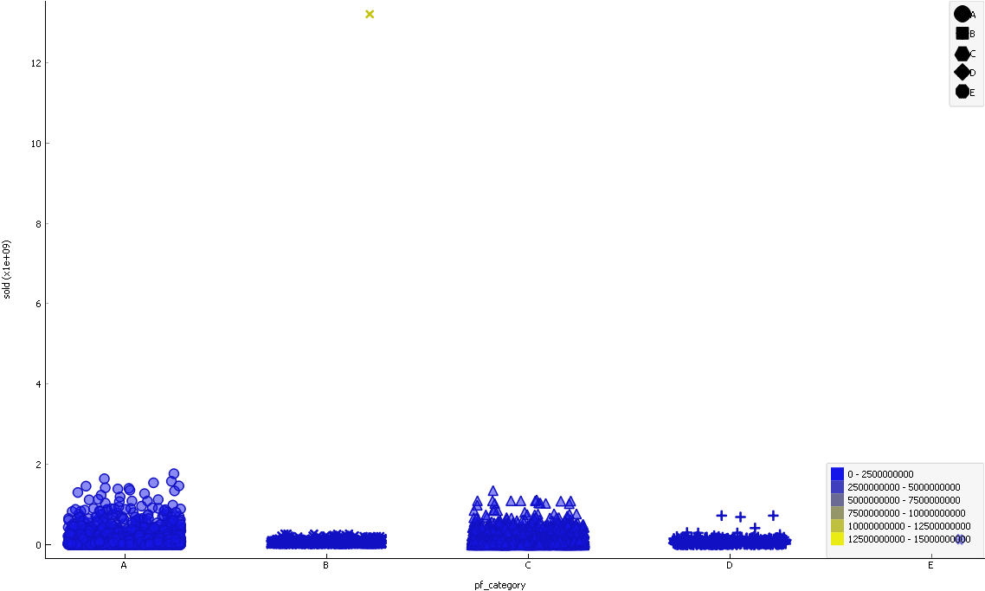
PF_CATEGORY AND SOLD [Train]

Slide 6
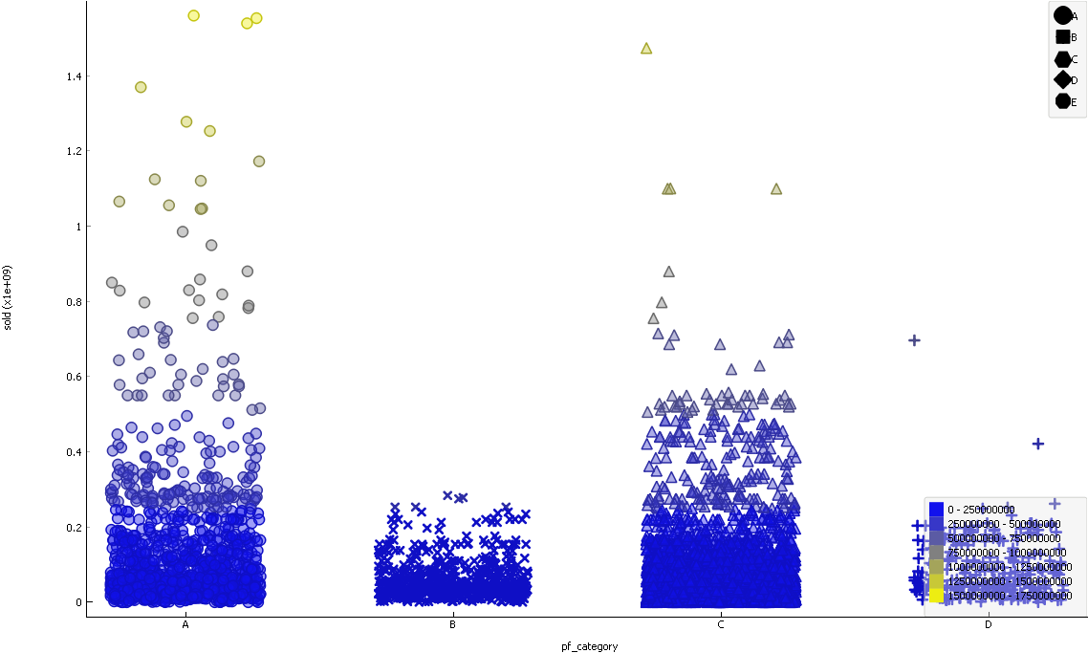
PF_CATEGORY AND SOLD [Test]

Slide 7
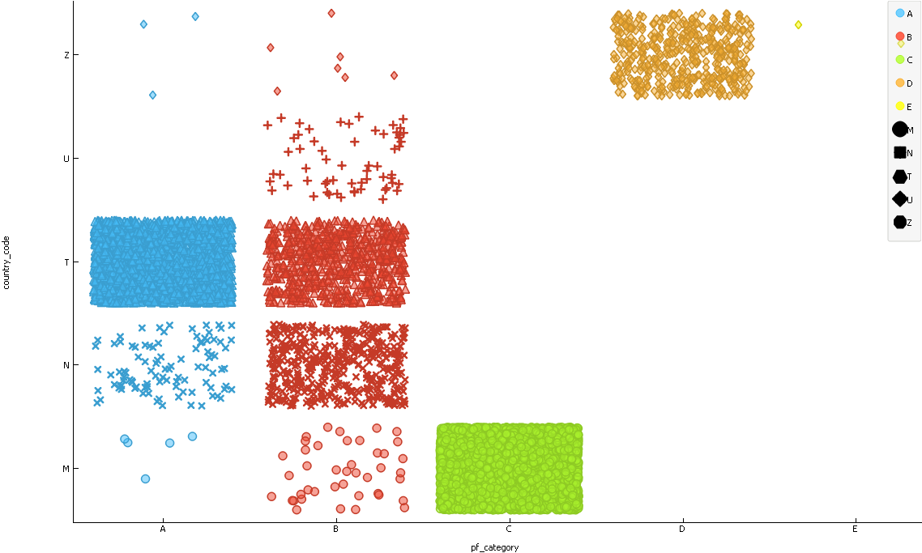
PF_CATEGORY AND COUNTRY_CODE[Train]

Slide 8
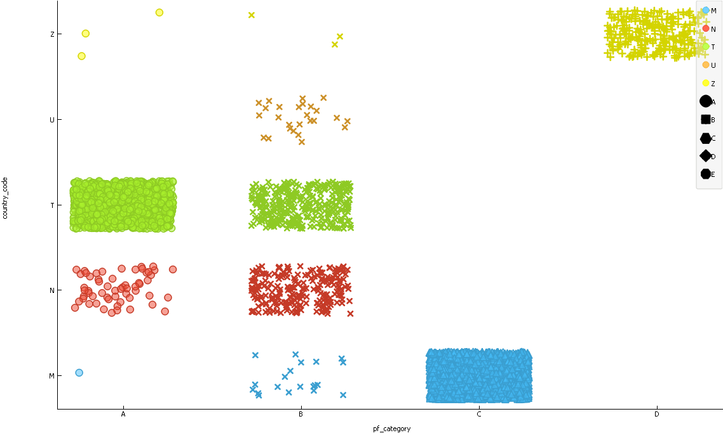
PF_CATEGORY AND COUNTRY_CODE[Test]

Slide 9
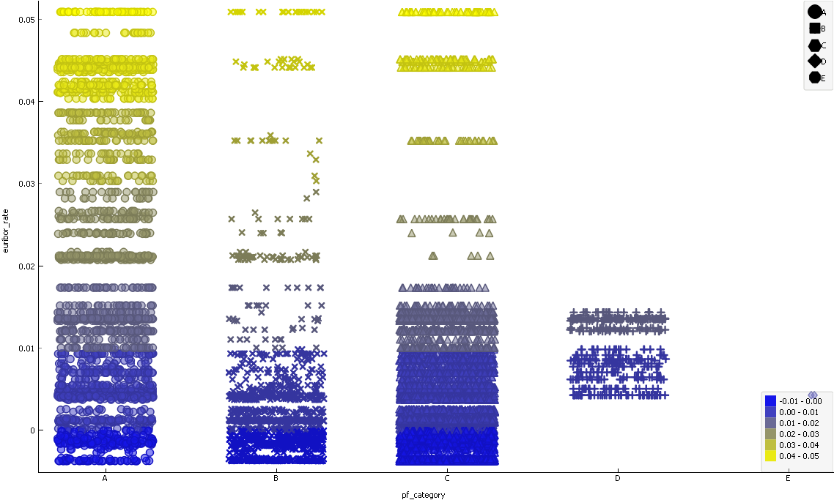
PF_CATEGORY AND EURIBOR RATE [Train]

Slide 10
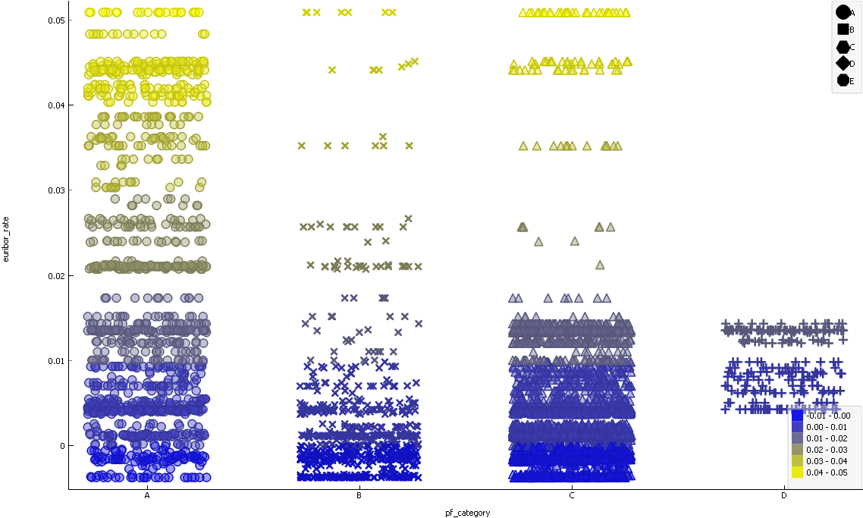
PF_CATEGORY AND EURIBOR RATE [Test]

Slide 11
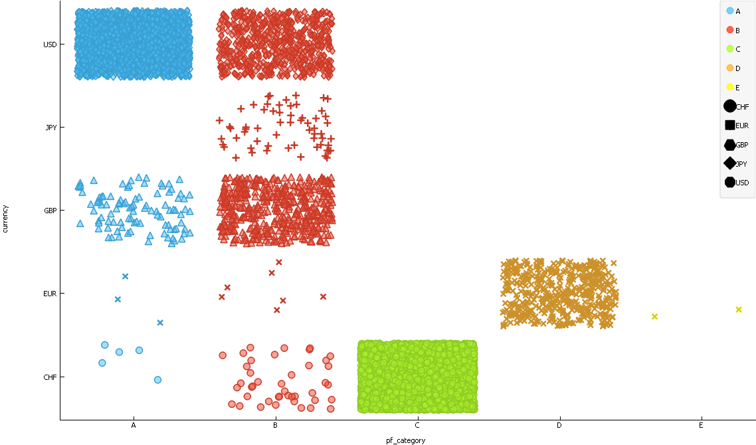
PF_CATEGORY AND CURRENCY [Train]

Slide 12
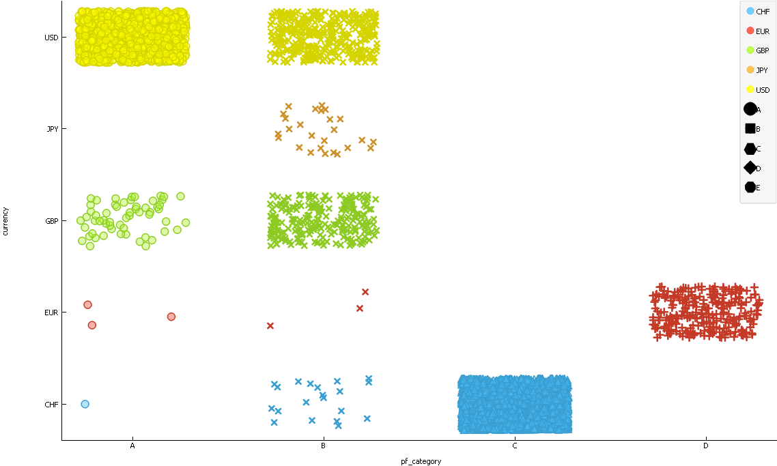
PF_CATEGORY AND CURRENCY [Test]

Slide 13
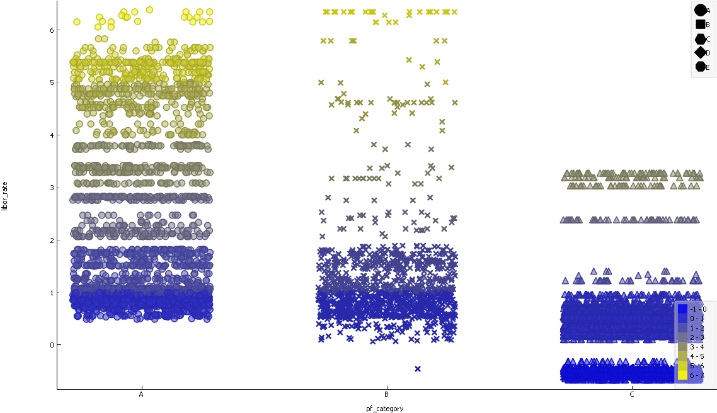
PF_CATEGORY AND LIBOR_RATE [Train]

Slide 14
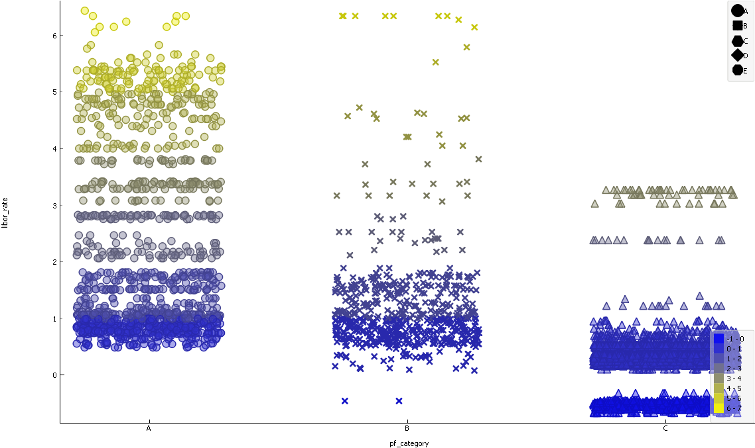
PF_CATEGORY AND LIBOR_RATE [Test]

Slide 15

PF_CATEGORY AND BOUGHT [Train]

Slide 16

PF_CATEGORY AND BOUGHT [Test]

Slide 17
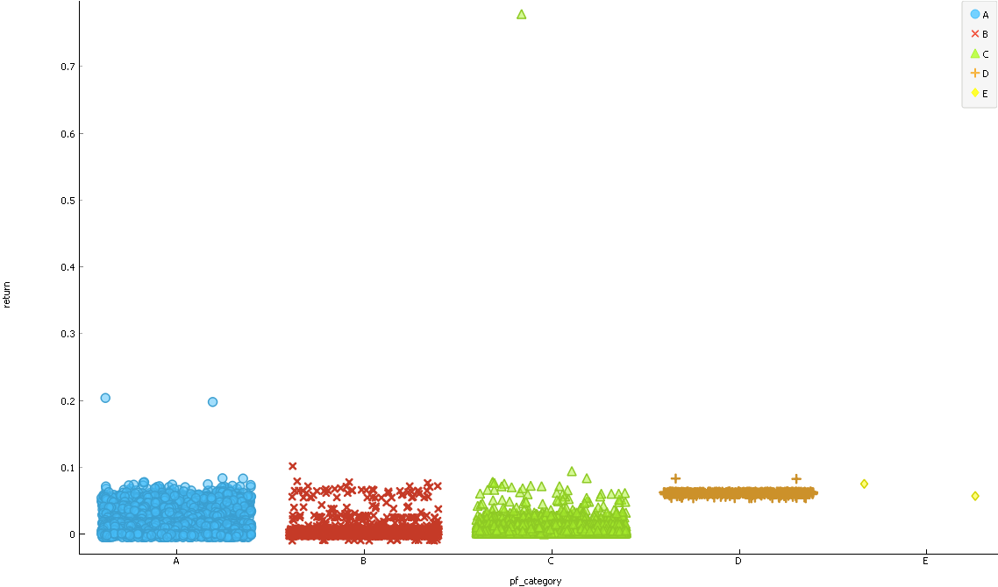
PF_CATEGORY AND RETURN [Train]

Slide 18
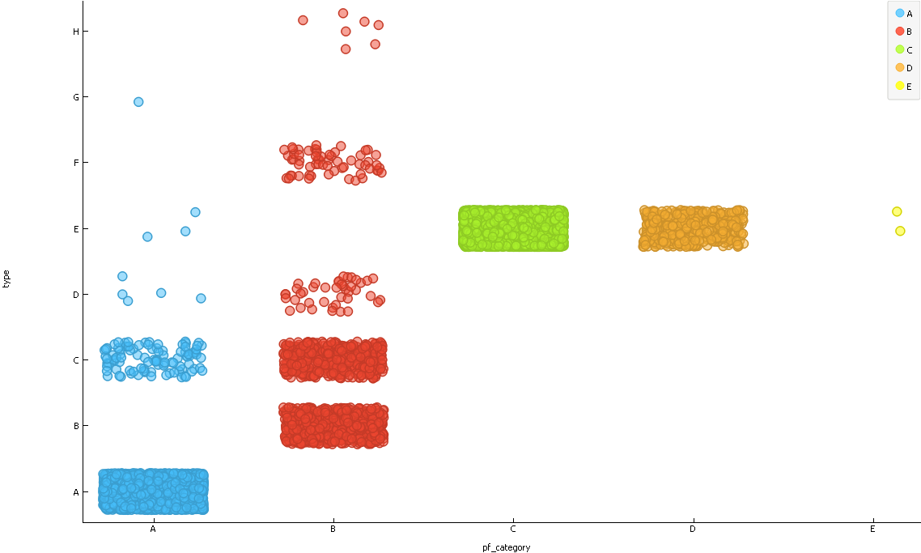
PF_CATEGORY AND TYPE [Train]

Slide 19
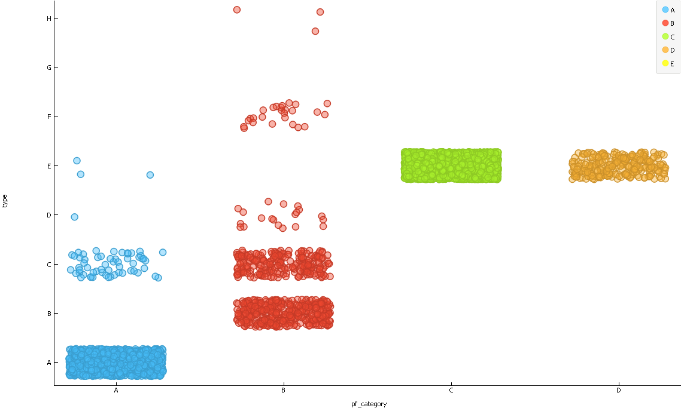
PF_CATEGORY AND TYPE [Test]

Slide 20
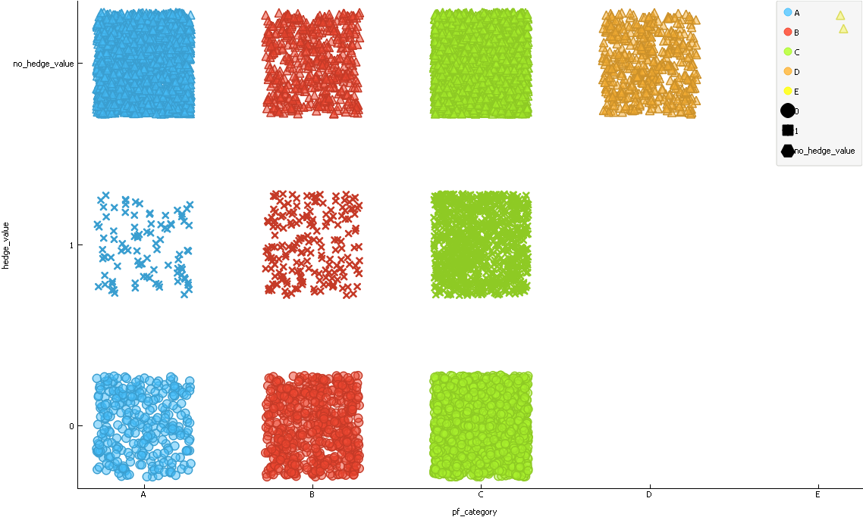
PF_CATEGORY AND HEDGE_VALUE[Trian]

Slide 21
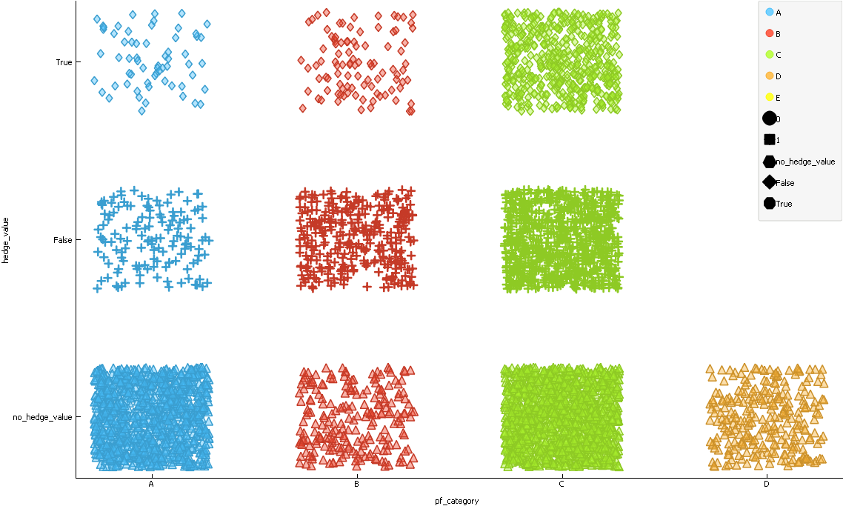
PF_CATEGORY AND HEDGE_VALUE[Test]

Slide 22
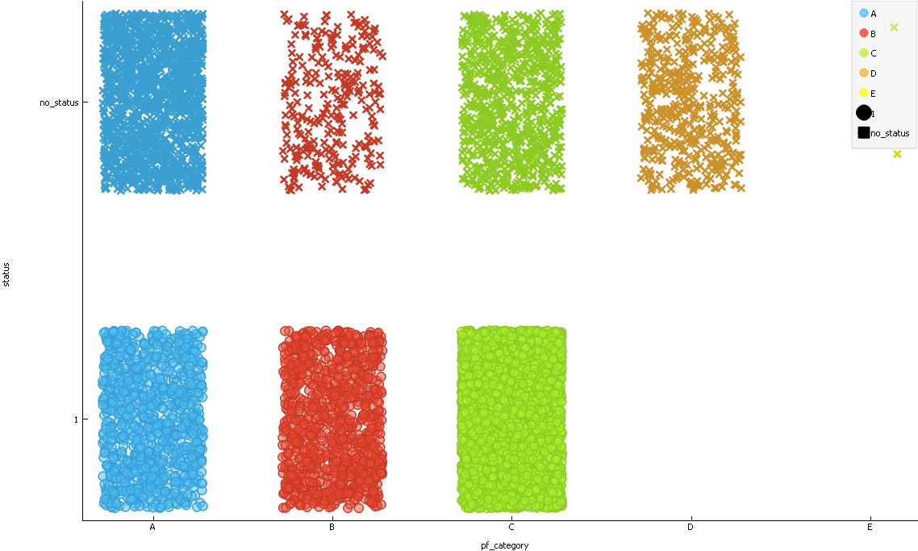
PF_CATEGORY AND STATUS [Trian]

Slide 23
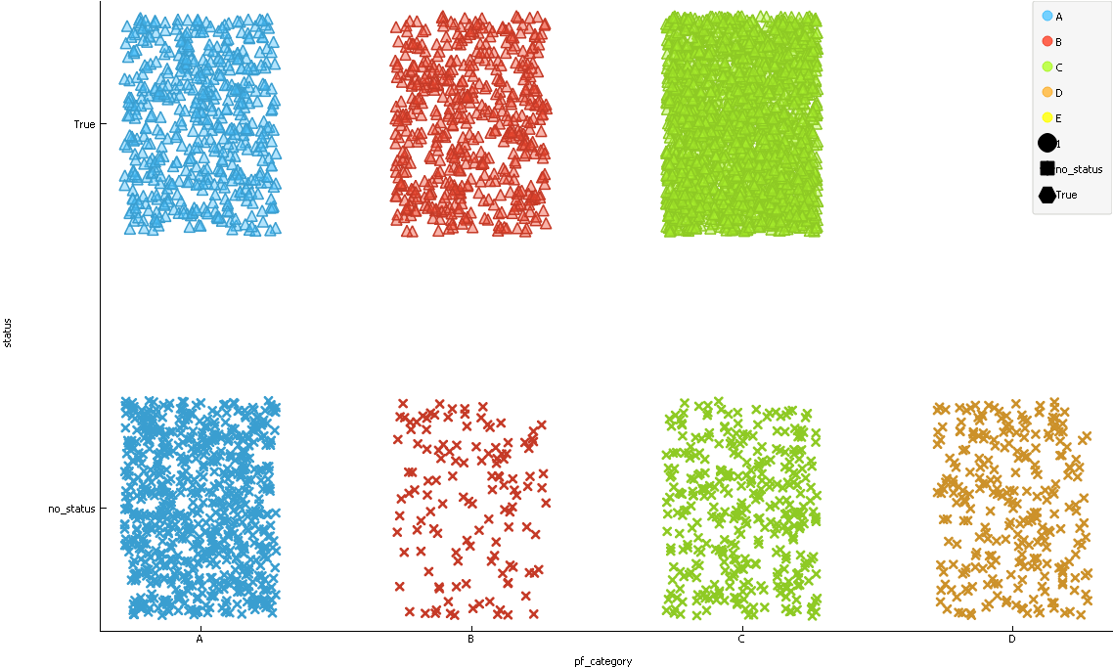
PF_CATEGORY AND STATUS [Test]

Slide 24
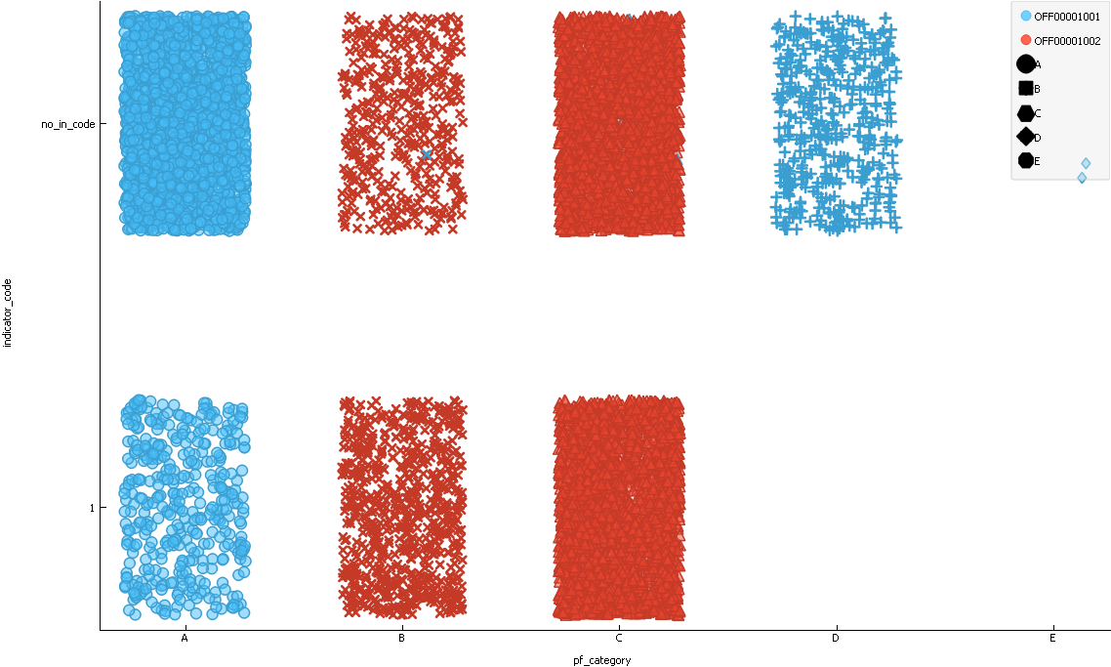
PF_CATEGORY AND INDICATOR_CODE [Train]

Slide 25
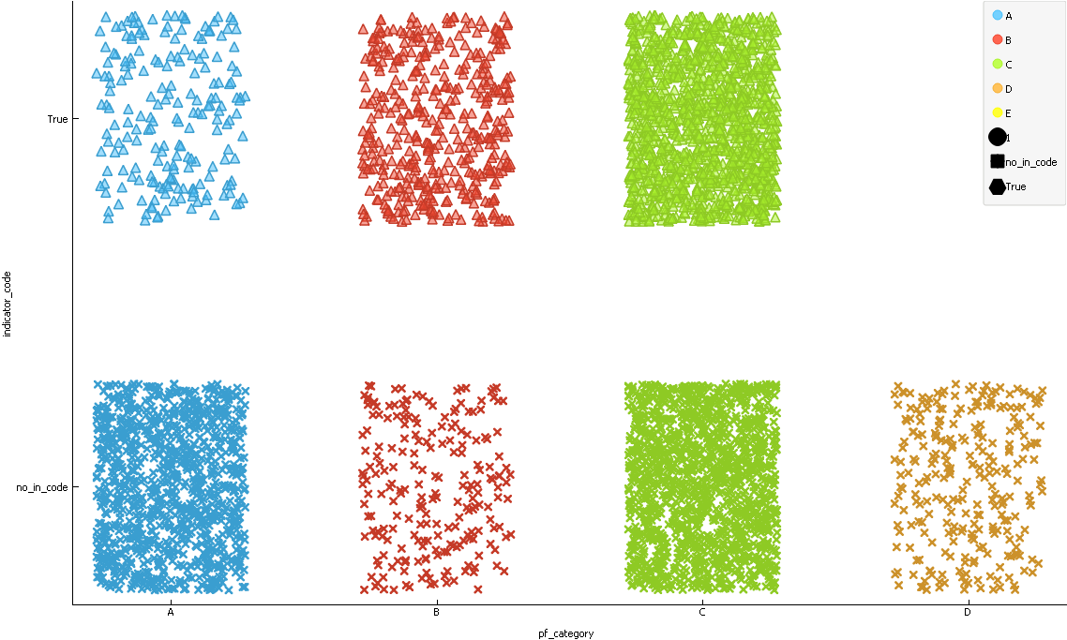
PF_CATEGORY AND INDICATOR_CODE [Test]

Slide 26
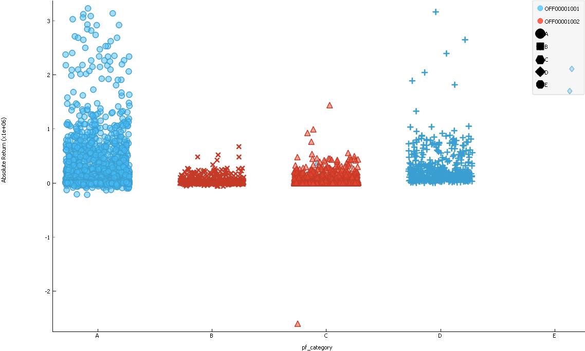
PF_CATEGORY AND ABSOLUTE_RETURN [Train]

Slide 27
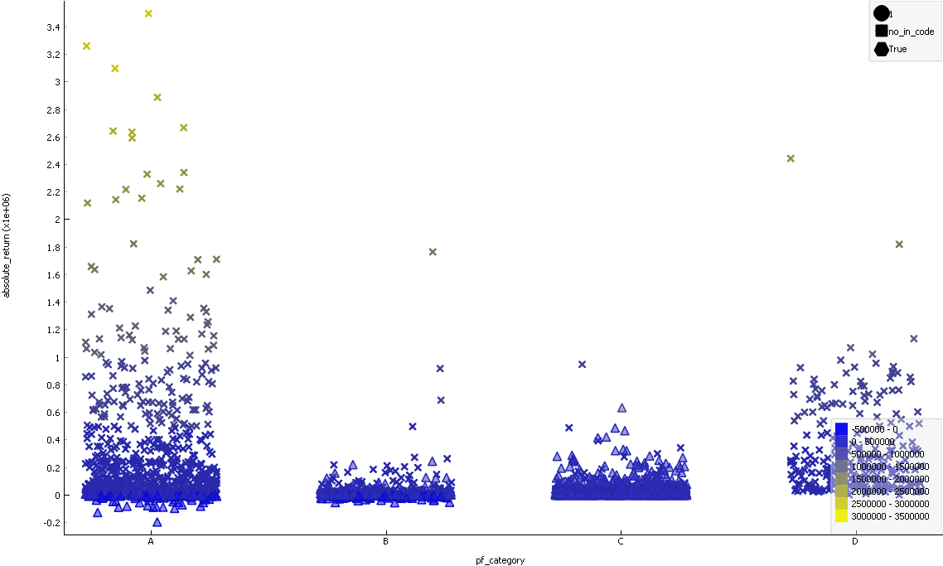
PF_CATEGORY AND ABSOLUTE_RETURN [Test]

Slide 28
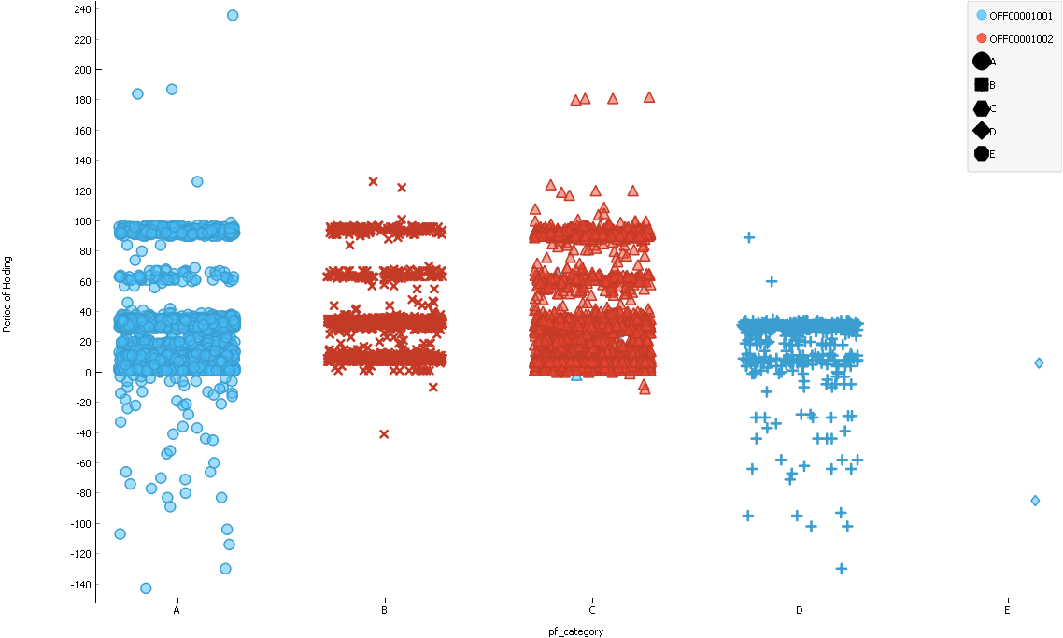
PF_CATEGORY AND PERIOD OF HOLDING [Train]

Slide 29
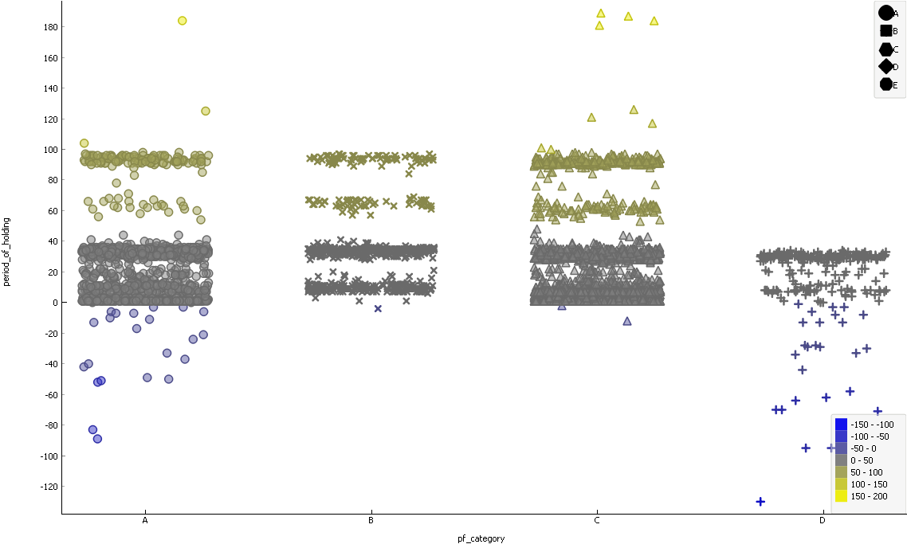
PF_CATEGORY AND PERIOD OF HOLDING [Test]

Slide 30
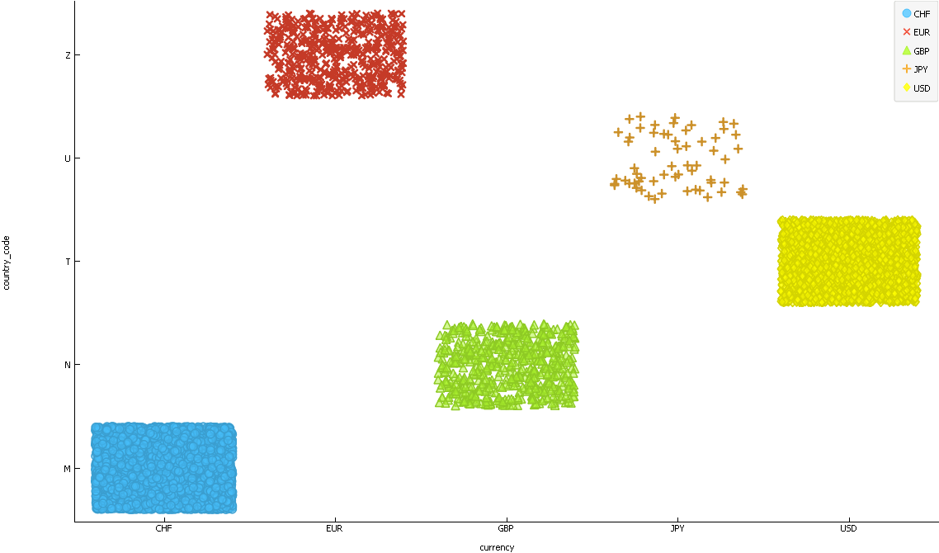
COUNTRY AND CURRENCY [Train]

Slide 31
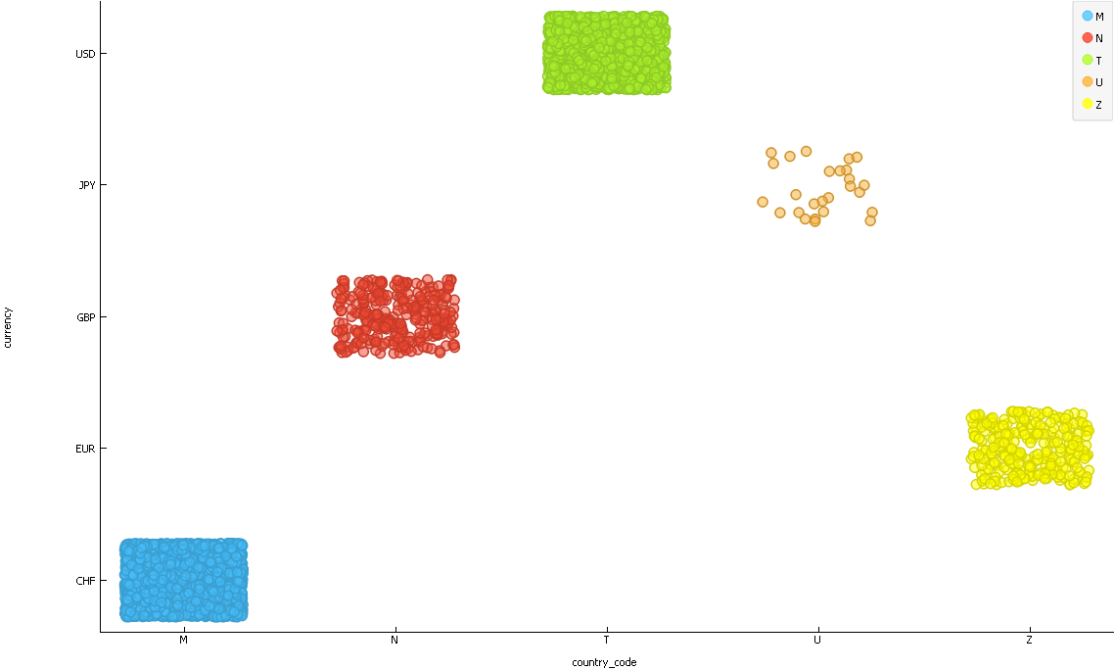
COUNTRY AND CURRENCY [Test]

Slide 32
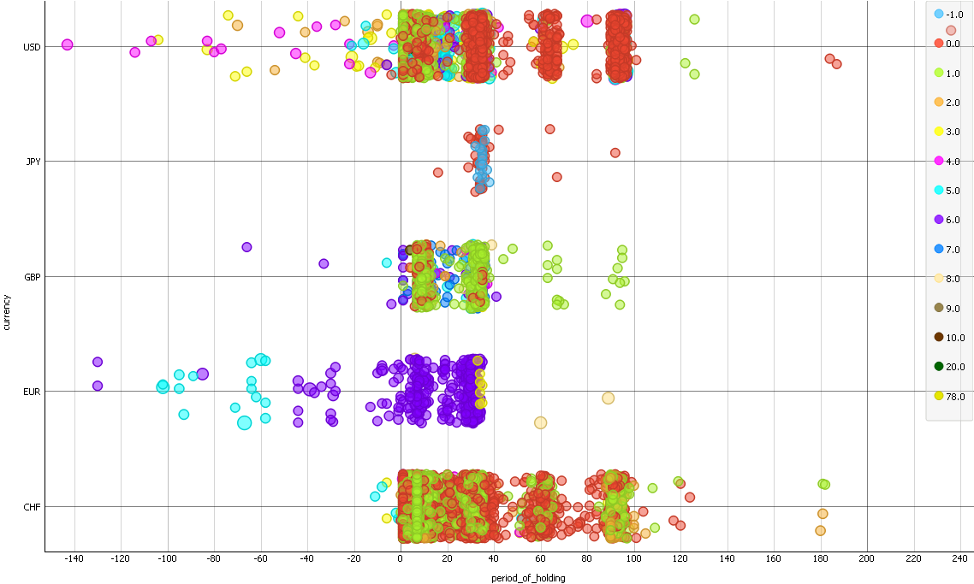
CURRENCY AND PERIOD_OF_PORTFOLIO AND RETURN [Train]

Slide 33
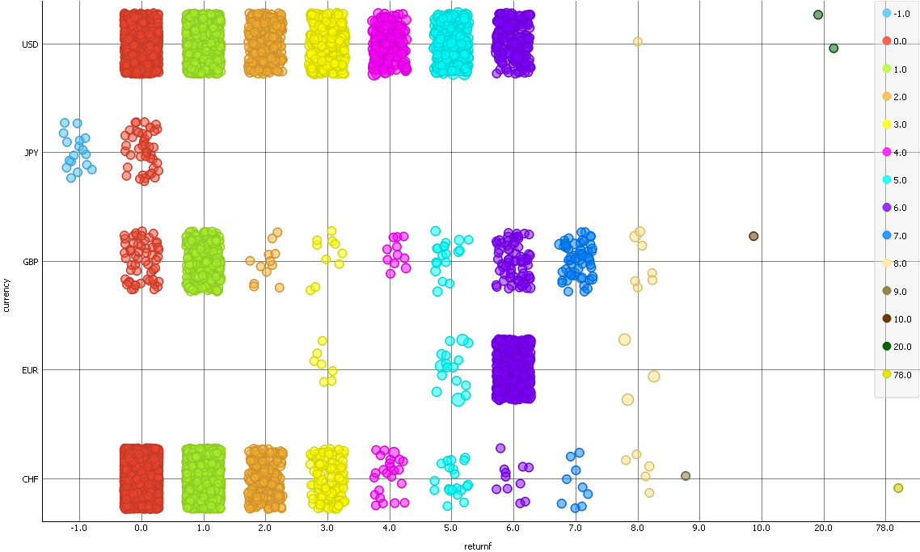
CURRENCY_RETURN [Train]

Slide 34
YEAR AND ABSOLUTE RETURN

Slide 35
YEAR AND RETURN

Slide 36
STATEMENTS OBTAINED
Problem Statement : To find the return for the portfolios, given by Societe General.
Here where portfolio for 5 countries are handled.
Portfolio_id is in consecutive format.
Maximum present in training set and minimum in testing set.
The portfolio_id selected for training set and testing set are random.
Some portfolio_id are missed in both training set and testing set.
The values of portfolio are unique.
The portfolios are handled by some manager.
Those manager are given with desk_id.

Slide 37
CONT...
Some manager who handles more than one portfolio_id.
All desk_id which comes under two office_id.

